Slide 1

FruityTech Studio
“Play. Place. Create.” Game-like educational tool
Group #15
Logan Jordan - UI/UX Engineer
Kanstansin Nechyparenka - Project Manager and Gameplay Engineer
Allam Syahriza - Audio Features Engineer

Slide 2
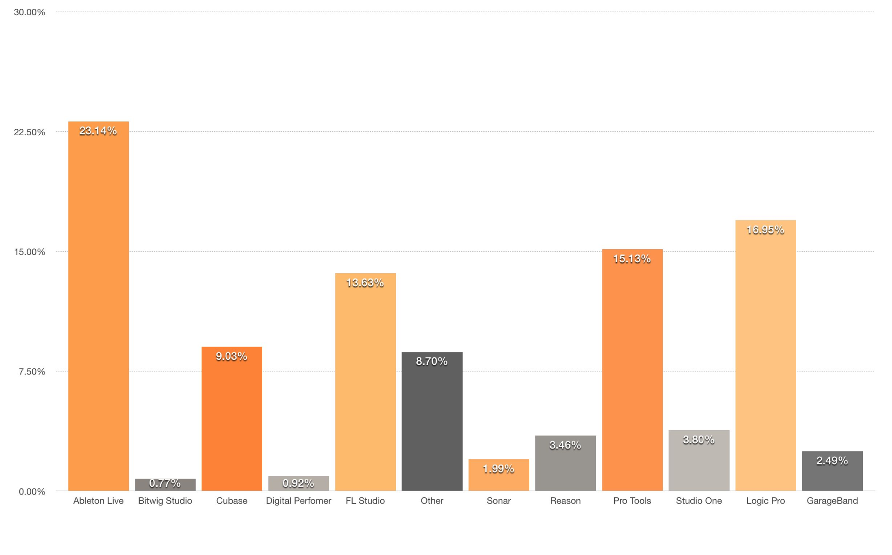
What are we trying to do? What is FruityTech studio application ?
Ableton Live, Logic Pro, FL Studio, GarageBand, Chrome Music Lab
They are all drastically vary on the entry skills
FruityTech Studio makes music creation simple and as a playable educational tool for people who seeking themselves in music creation
No previous experience, beginner-friendly and interactive, with a broad features scale
Source MacProVideo - The Top 11 Most Popular DAWs

Slide 3
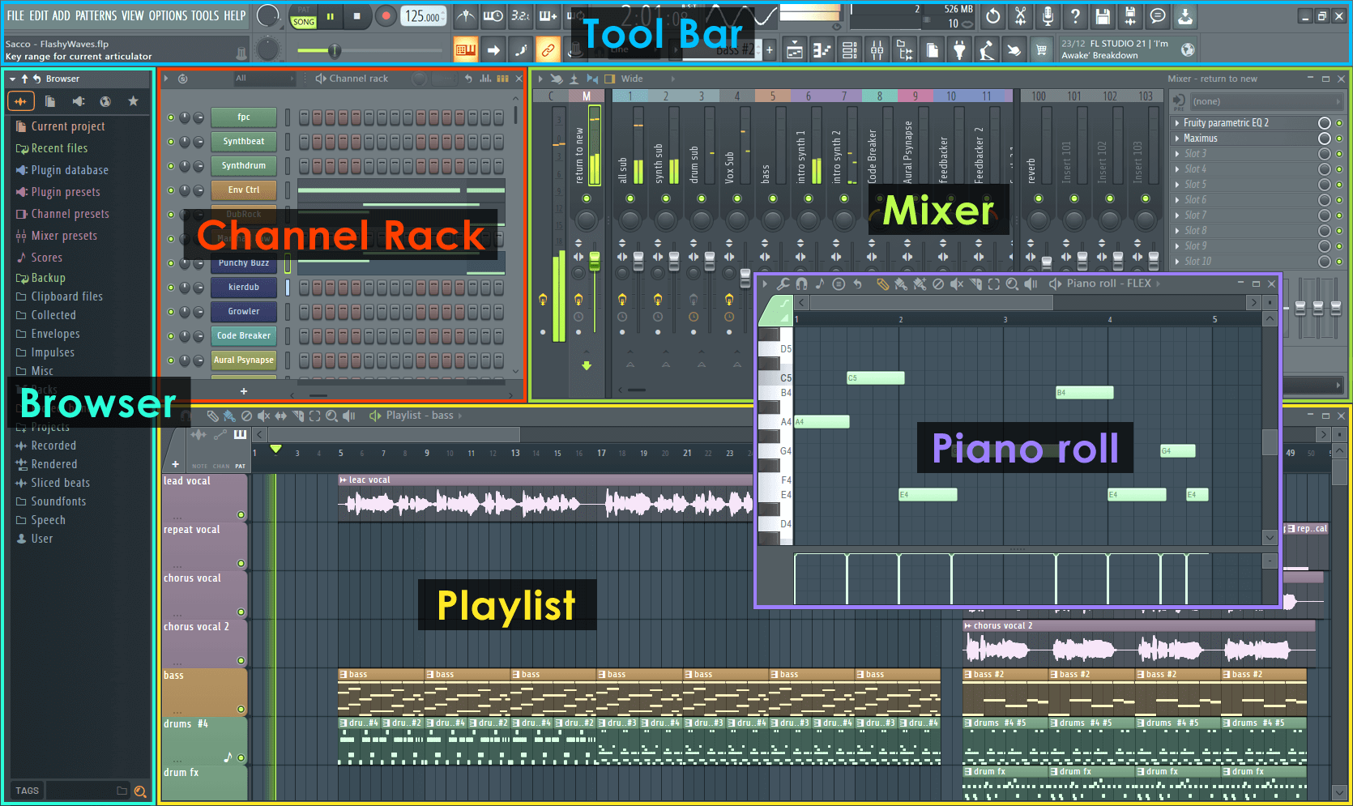
How is it done today and what are the limits of current practice?
How it is done today:
DAWs (Ableton Live, FL Studio) rely on complex interfaces that require music theory and technical knowledge
Game like tools (Chrome Music Lab, Incredibox) are very limited in depth
Limits of current practice:
Advanced tools have a steep learning curve that discourage beginners
Simpler tools lack flexibility and creative depth
Most tools focus on technical workflows rather than learning and playful exploration
Source FL Studio Manual - Fl Studio User Interface
Notes:
Today, professional producers use complex Digital Audio Workstations or DAWs to make music. These include software like Ableton Live, FL Studio, and Logic Pro. They rely on separated music clips and piano rolls that require things like channels, mixing, timelines, loops, and other advanced concepts that require music theory and technical knowledge. They are very complicated, but they provide limitless music creation possibilities once mastered.
There are also simpler, game like music creation or experimentation tools. These include software like Chrome Music Lab and Incredibox. They simplify music creation with preloaded sounds and drag and drop loops. They don’t require any music knowledge and are easy for absolute beginners to pick up. The problem is that they are very limited in depth, and are treated more so as a game rather than a tool to learn how to make music.
The main problem we found is that there is no middle ground between the advanced DAWs and the simplified, game like softwares today. Advanced DAWs have a very steep learning curve and uninviting UI that discourages beginners and non musicians. While simpler tools lack flexibility, creative depth, and opportunities to transition into more advanced music making concepts that more advanced software allows.
Most tools also focus on technical workflows rather than learning and playful exploration. We want a simple software to be accessible and useful for all, absolute beginners to experienced producers. Software where users are able to not only play and experiment, but have the ability to make professional songs.

Slide 4
What is new in our approach that makes us believe it will be successful? Who cares? If you are successful, what difference will it make?
Makes music creation more beginner friendly
Straightforward UI
‘Gamified’ feeling
Simplified versions of common DAW features
Lowers the barrier of entry to learning music production
Cost
Hardware
No music theory needed
Can be used as a learning tool
Notes:
Not as overwhelming to look at as FL studio or ableton Placing objects in a virtual space, Will feel less like using a professional tool, and more like playing a game Most DAWs (Fl, ableton) are $100 minimum, can be hundreds more. Won’t have to buy plugins, addons, or worry about physical hardware (just computer itself) Will be very lightweight, can be run on any device.

